Slide 1


WeASSIST
Process optimization in one minute

Slide 2
Short introduction
First Last Name
Position
first.last@werma.com
Tel: +1 (470) 361-0600
Cell: +1 (678) 301-0154
WERMA
Product Manager
Oct. 2021 – Today
Notes:
Short introduction:
- One or two sentences about yourself and how long you have been working in your field at WERMA

Slide 3






WERMA at a glance
Headquarters
Germany - South
390 Employees
European Market Leader
Signalization and Systems for diverse Industries
Notes:
WERMA at a glance:
Location in the south of Germany, second plant in China
390 employees
European market leader in the field of signaling technology
Also represented in the field of signaling technology systems for several years

Slide 4
Challenges
Notes:
Challenges:
Introduction to the topic
The following is an example of how it works in many production facilities
Designed to illustrate frequently occurring problems

Slide 5
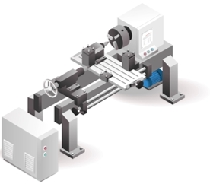
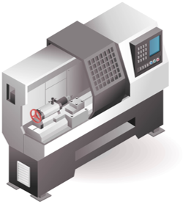
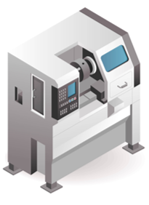
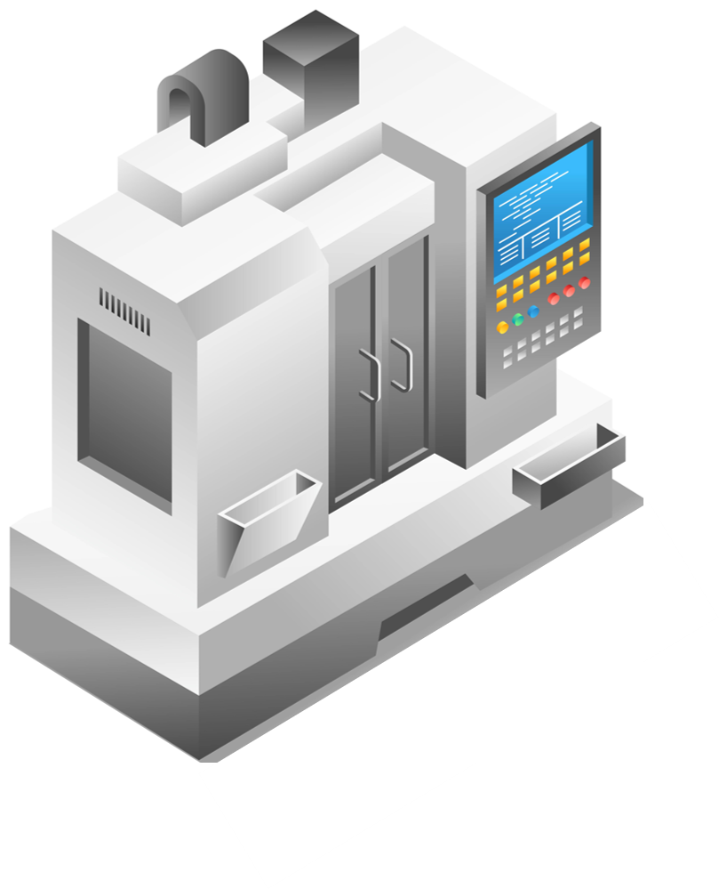


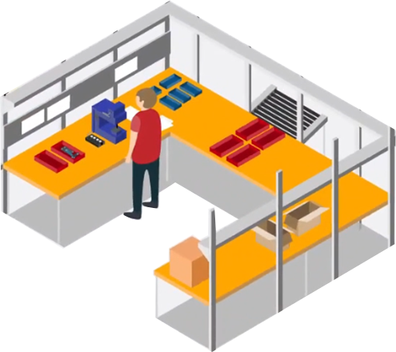


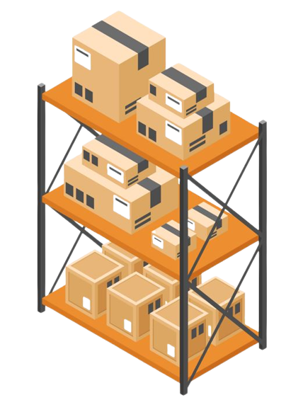
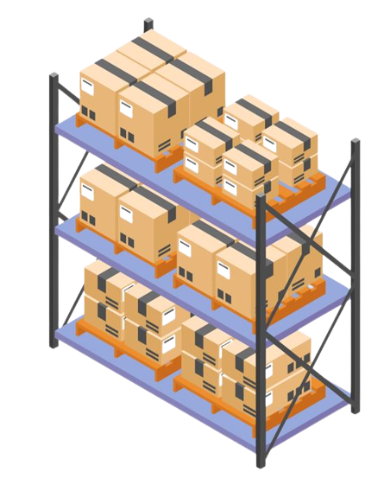

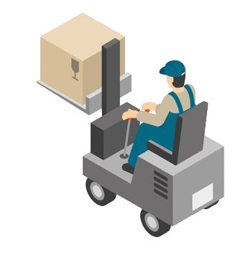
Machines
Manual Workstations
Intralogistics
Shift Supervisor
Notes:
Introduction:
Structure of a classic production
Includes various machines such as CNC machines, machining centers, conventional machines
Usually includes manual workstations (1st click)
Usually includes intralogistics (2nd click)
Usually includes a shift supervisor position or similar (3rd click)

Slide 6

Missing Transparency
Notes:
Lack of transparency:
Machine goes into fault mode and no one notices immediately
Lack of transparency as the cause (1st click)

Slide 7

Missing Transparency
Long response times
Notes:
Long response time:
Fault is only detected after a certain time
Employee cannot rectify fault himself and needs help (1st click)

Slide 8

Missing Transparency
Long response times
Search- & Walk time
Notes:
Search- and Walk time:
Way to the master workplace, but no contact person present
Classic search and walk times occur until the responsible person is found

Slide 9

I need help with Machine 1!
Missing Transparency
Long response times
Search- & Walk time
Help on Call
Notes:
Help on call:
Search and walk times continue to increase until the contact person is found
Help is now provided on request to see if the contact person can help (1st click)

Slide 10
Missing Transparency
Long response times
Search- & Walk time
Help on Call
Notes:
Help on call and travel times:
Help is confirmed by contact person
Machine downtime increases further

Slide 11

Duration of Machine downtime?
Missing Transparency
Long response times
Search- & Walk time
Help on Call
Unknown Downtimes
Notes:
Unknown downtime:
No statement can be made on the question of downtime (1st click)
Only downtime estimations possible, due to no data acquisition

Slide 12



Missing Transparency
Long response times
Search- & Walk time
Help on Call
Incident causes?
Downtimes?
Cycle Times?
Productivity?
Unknown Downtimes
Unknown Causes for Incidents
Missing KPIs
Notes:
Unknown Causes for Incidents and KPIs:
Production manager would like to know the last reasons for disruption (1st click)
He would also like to know other key figures (2nd-4th click)
No information can be provided as no data is available (5th click)

Slide 13

Customer Insights
Waiting and idle times regularly occur at our assembly and packing workstations due to a lack of material supplies.
Tobias Weißhaar
Metabo
It is not possible to generate precise key figures on capacity utilization, order status or productivity.
Bas van Nes
Flestic
Machine downtimes and malfunctions are only detected by the worker upon inspection and then reported to the responsible persons.
Stefan Wetzel
Marquardt
Notes:
Voices from the market:
Regular waiting and idle times at Metabo
No precise key figures at Flestic
Malfunctions only on sighting at Marquardt

Slide 14
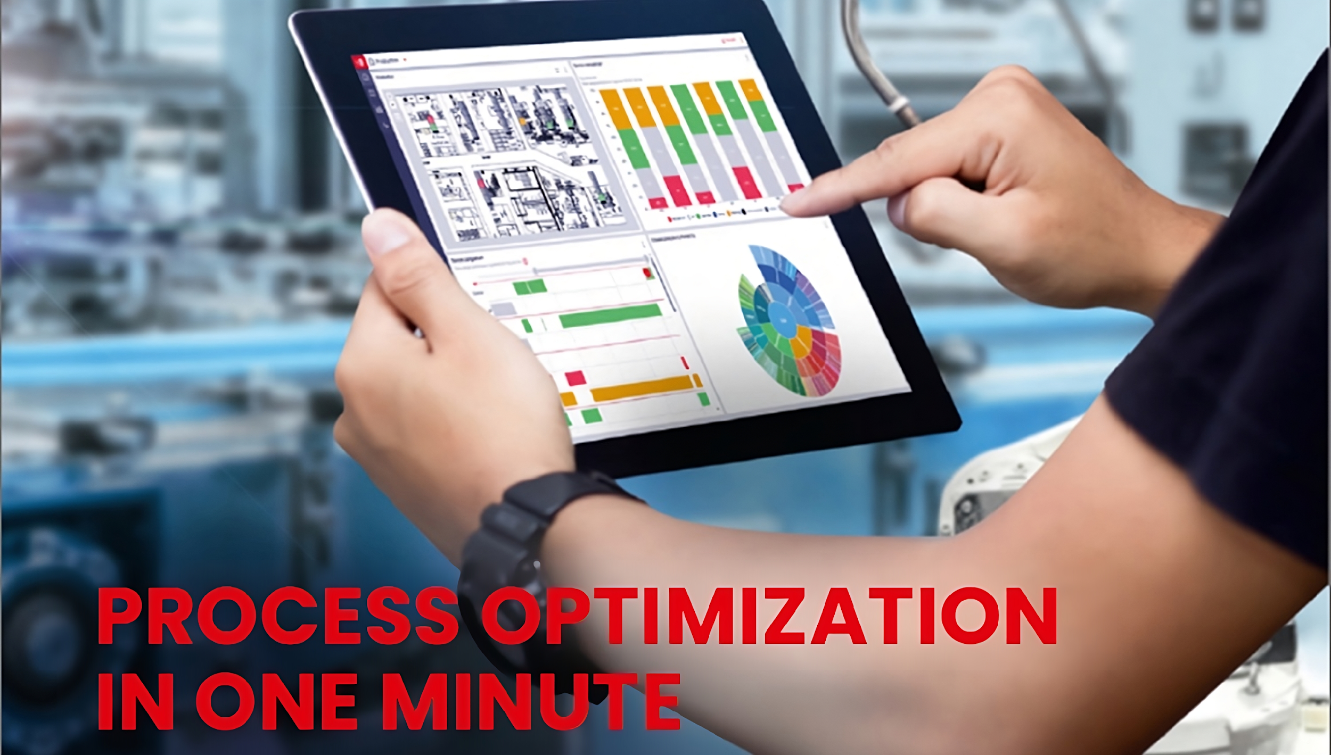
Solutions
Notes:
Solution approach with WERMA system solution:
- Presentation of how problems can be solved

Slide 15
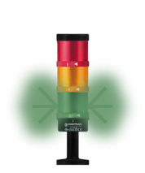


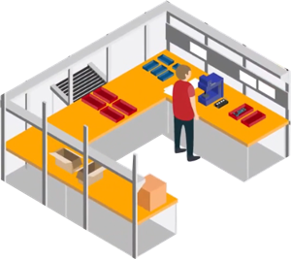
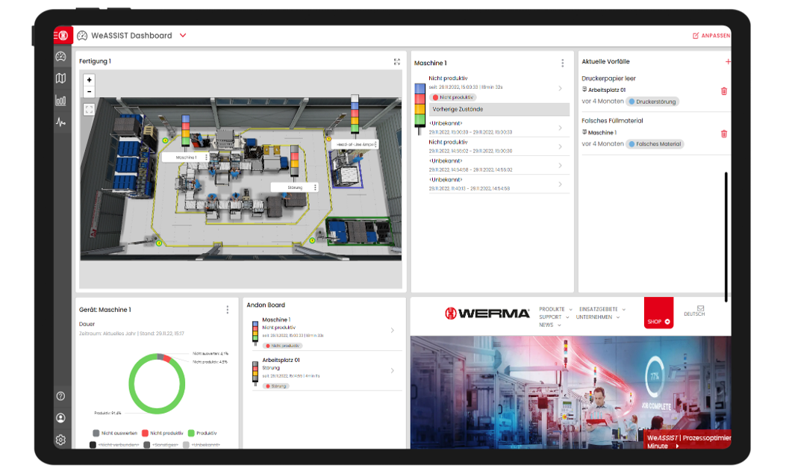
Full Transparency
Missing Transparency
Long response times
Search- & Walk time
Help on Call
Unknown Downtimes
Unknown Causes for Incidents
Missing KPIs
Notes:
Full transparency:
To create visual transparency for all employees
Signal towers at all workstations (1st click)
Send the status of all workstations to a central location (2nd click)
This provides a simple overview of all machines and workstations

Slide 16
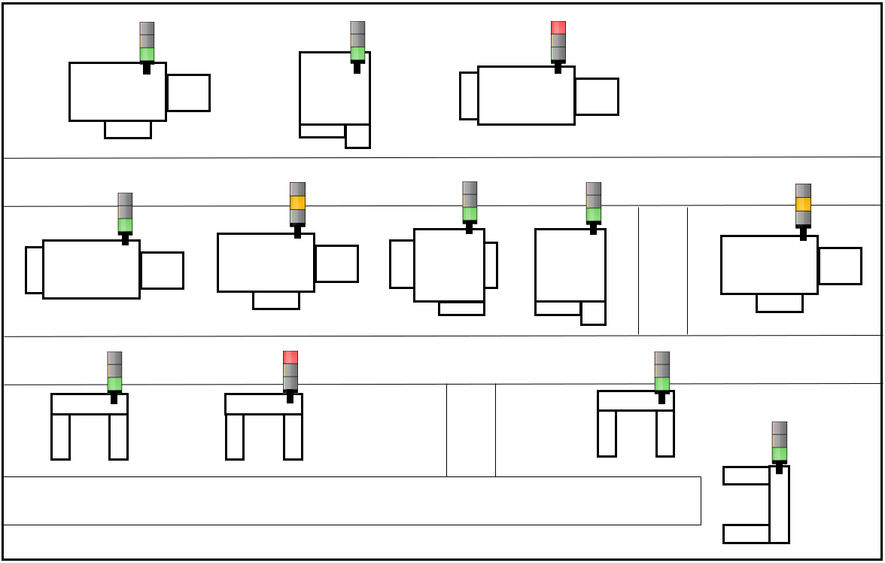
Notes:
Floor plan:
Simple overview of all machines and workstations
Constant overview of which machine/workstation is in production or malfunctioning

Slide 17
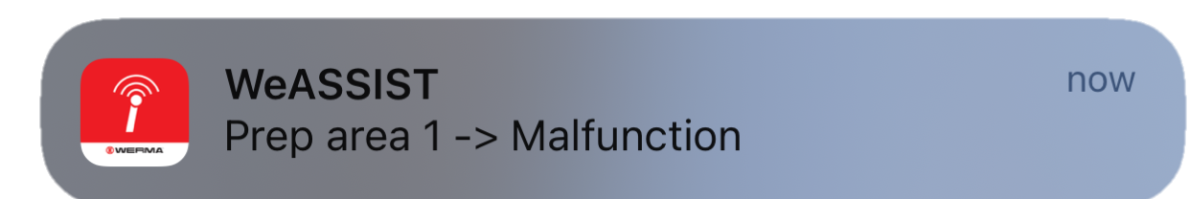
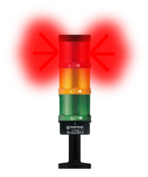

Full Transparency
Fast Response Times
Long response times
Lange Reaktionszeit
Search- & Walk time
Help on Call
Unknown Downtimes
Unknown Causes for Incidents
Missing KPIs
Notes:
Fast response time:
Employee receives notification of fault directly
Thus significantly shorter response time than before

Slide 18
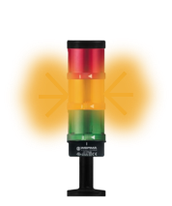

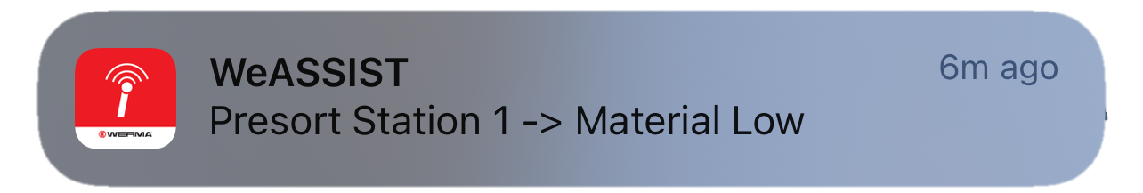
Full Transparency
Fast response times
No Search- & Walk times
Search- & Walk time
Help at the touch of a button
Help on Call
Unknown Downtimes
Unknown Causes for Incidents
Missing KPIs
Notes:
No search and travel times / help at the touch of a button:
Search and travel times are completely eliminated, as requirements can be transmitted directly to the person concerned
Simple integration of intralogistics, for example
Requests are simply submitted at the touch of a button
Forklift driver also able to acknowledge that he is coming and activates a light on the manual workstation, so the operator knows that somebody is coming with the material

Slide 19



Full Transparency
Fast response times
No Search- & Walk times
Help at the touch of a button
Downtimes recorded
Unknown Downtimes
Documented Causes
Unknown Causes for Incidents
Missing KPIs
Notes:
Recorded downtimes / documented reasons for malfunctions:
Machine malfunction has been rectified and can now be easily documented
Thus recorded downtime and documented reason for the malfunction

Slide 20
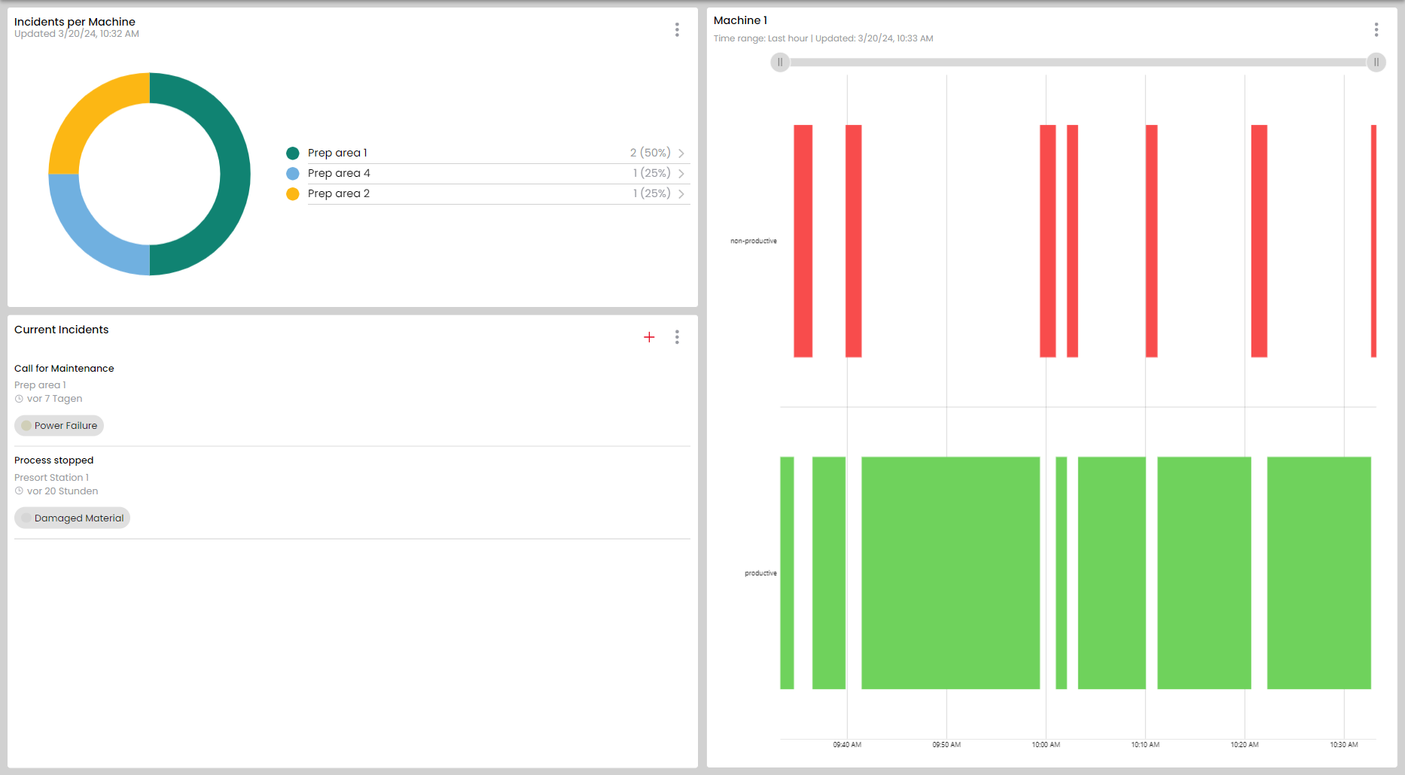
Fault overview for machines
Recorded Machine Downtime
Current Week
Machine 1
Machine 2
Assembly Station 1
List of current Incidents
Machine 1
Assembly Station 1
Notes:
Documentation downtime and reason for fault:
On the right-hand side, you can see how long the malfunction lasted in a kind of runtime diagram
At the bottom left you can see all faults that are currently present in production
And also at the top left an overview of which machines or workstations have been affected more frequently recently

Slide 21
Full Transparency
Fast response times
No Search- & Walk times
Help at the touch of a button
Downtimes recorded
Don‘t worry!
Documented Causes
KPIs?
KPIs available
Missing KPIs
Notes:
Key figures available:
- Key figures can now be easily supplied at the request of the production manager

Slide 22
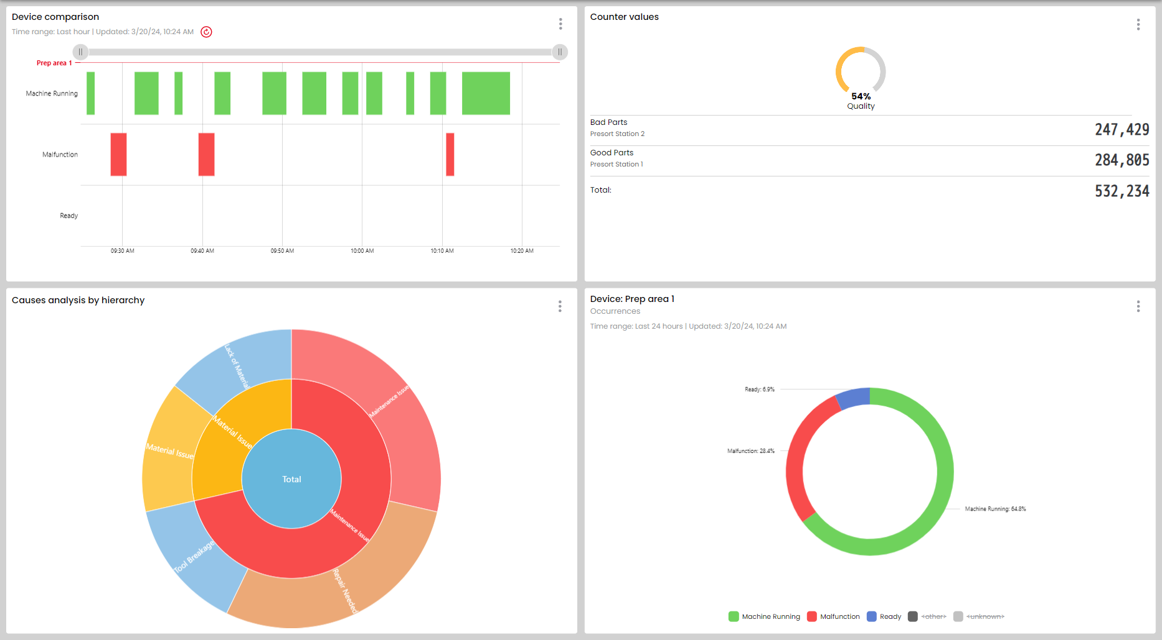
Machine Runtime
Quantity Display
Fault Reason Overview
Status Analysis
Notes:
Key figures:
At the top right you can see the machine running times of any selected machine
Below this, you can see the malfunction reason overview with a percentage distribution
To the right, you can see which states are present on any machine
You now also have the option of easily displaying the quantities at a workstation.

Slide 23
Customer Insights
Material replenishment can be requested at the touch of a button.
No more waiting and idle times thanks to the WERMA system solution.
Tobias Weißhaar
Metabo
Reliable data on the process stability of the machine is generated automatically.
Thanks to the WERMA system solution, full transparency for KPIs at the touch of a button.
Bas van Nes
Flestic
Machine downtimes and faults are detected within seconds.
Due to shorter response times thanks to the WERMA system solution, productivity increase of 10 %.
Stefan Wetzel
Marquardt
Notes:
Voices from the market:
Material replenishment at the touch of a button and no more waiting and idle times
Reliable data that is generated automatically. Facts and figures at the touch of a button
Downtimes and faults recorded within seconds. Productivity increase of 10%

Slide 24
What is
WeASSIST
all about?
Notes:
Introduction of WeASSIST
First starting with the system history at WERMA
After that more details to WeASSIST

Slide 25
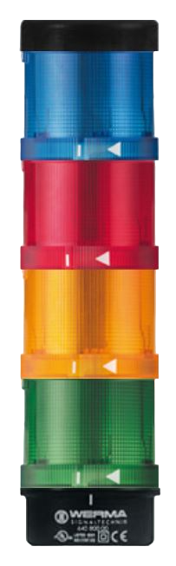
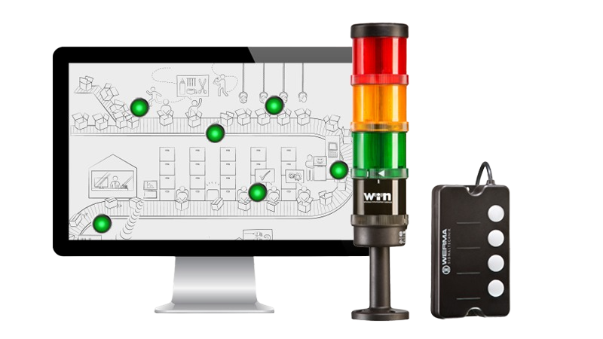
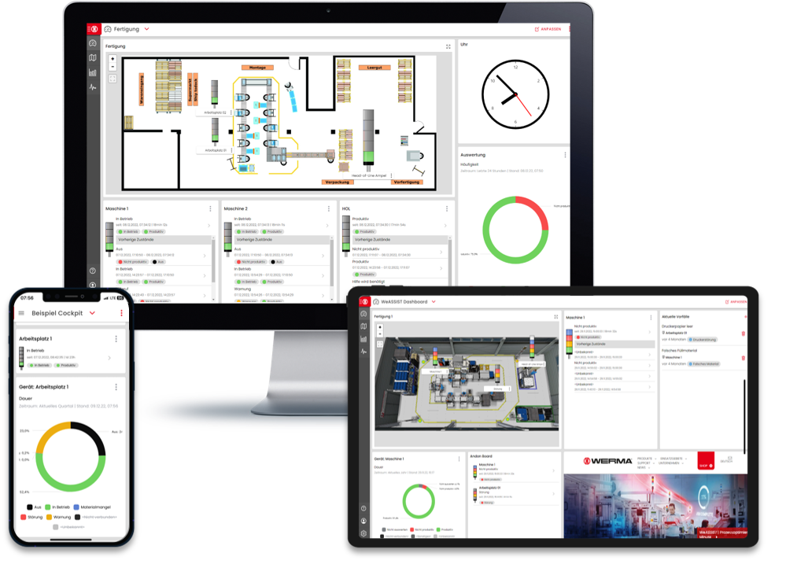
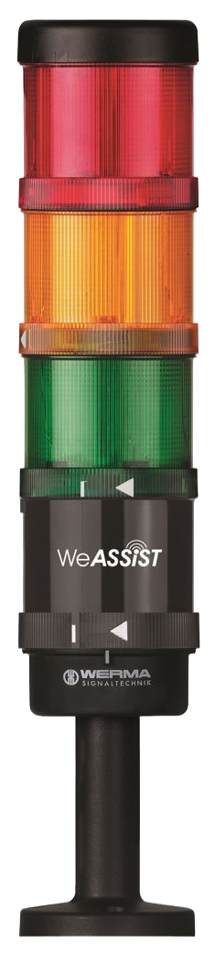
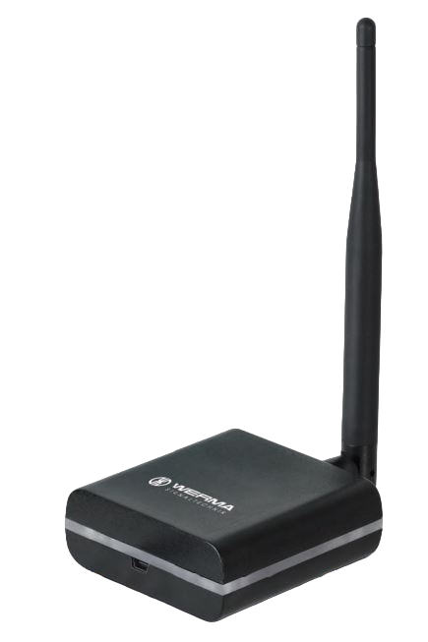
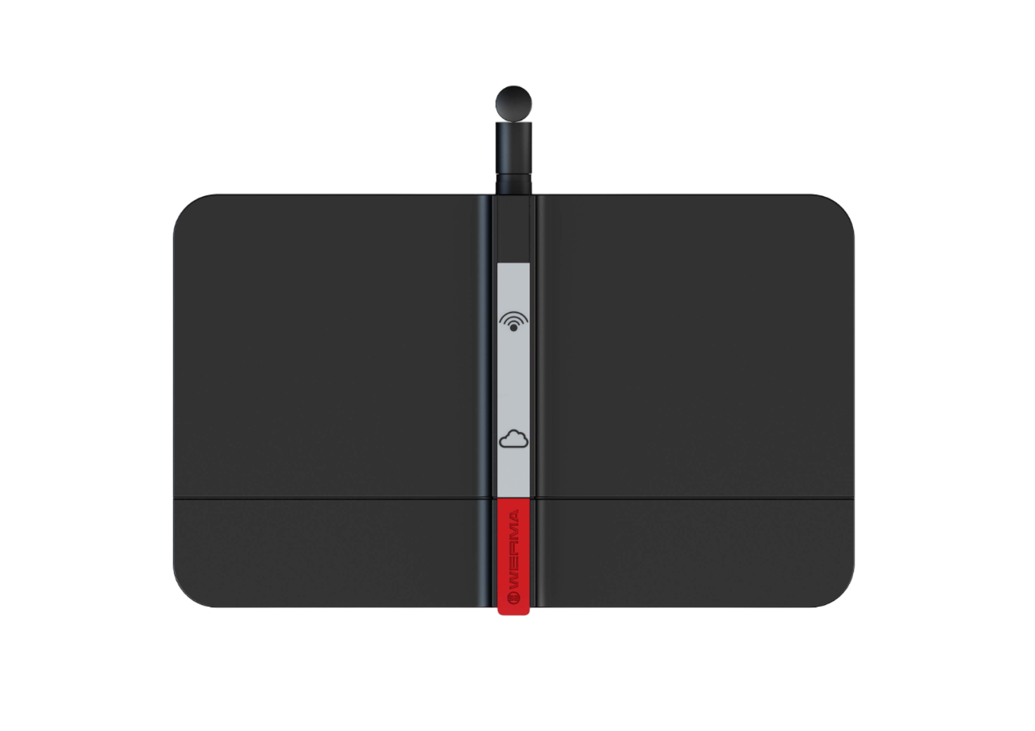
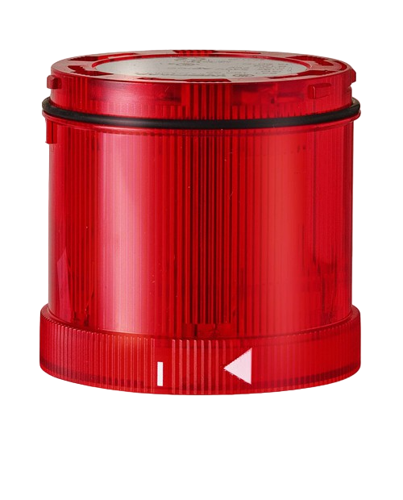
30 years of Process Optimization
Modular Signal Tower
SmartMONITOR
AndonSPEED
WeASSIST
Next Generation
One cloud-based platform for
all system modules
Established as Industry Standard
MDA-Alternative
for the whole Production
Addition for Process Optimization in shipping logistics or manual Workstations
1994
2009
2016
2022
Notes:
30 years of process optimization:
Start with modular signal tower in 1994
First system approach with SmartMonitor 🡪 Transceiver in signal tower which provides data for the transparency of all workstations
Addition of AndonSPEED for manual workstations and logistics 🡪 SmartBOX for manual switching (call- & Notification system)
Since 2022, all functionalities combined in one solution 🡪 WeASSIST in the cloud, which offers many other advantages

Slide 26


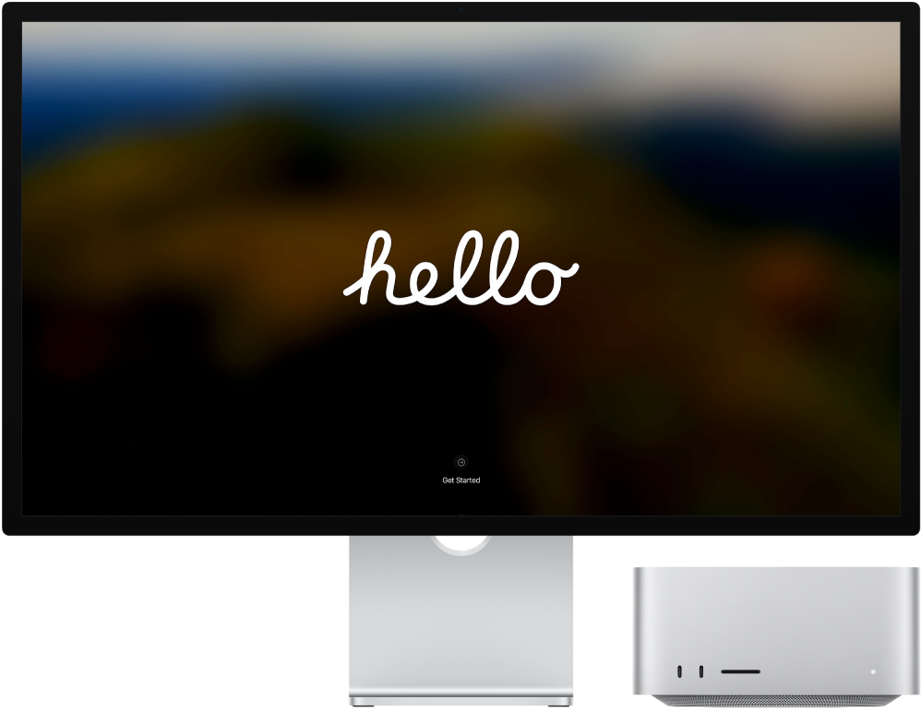
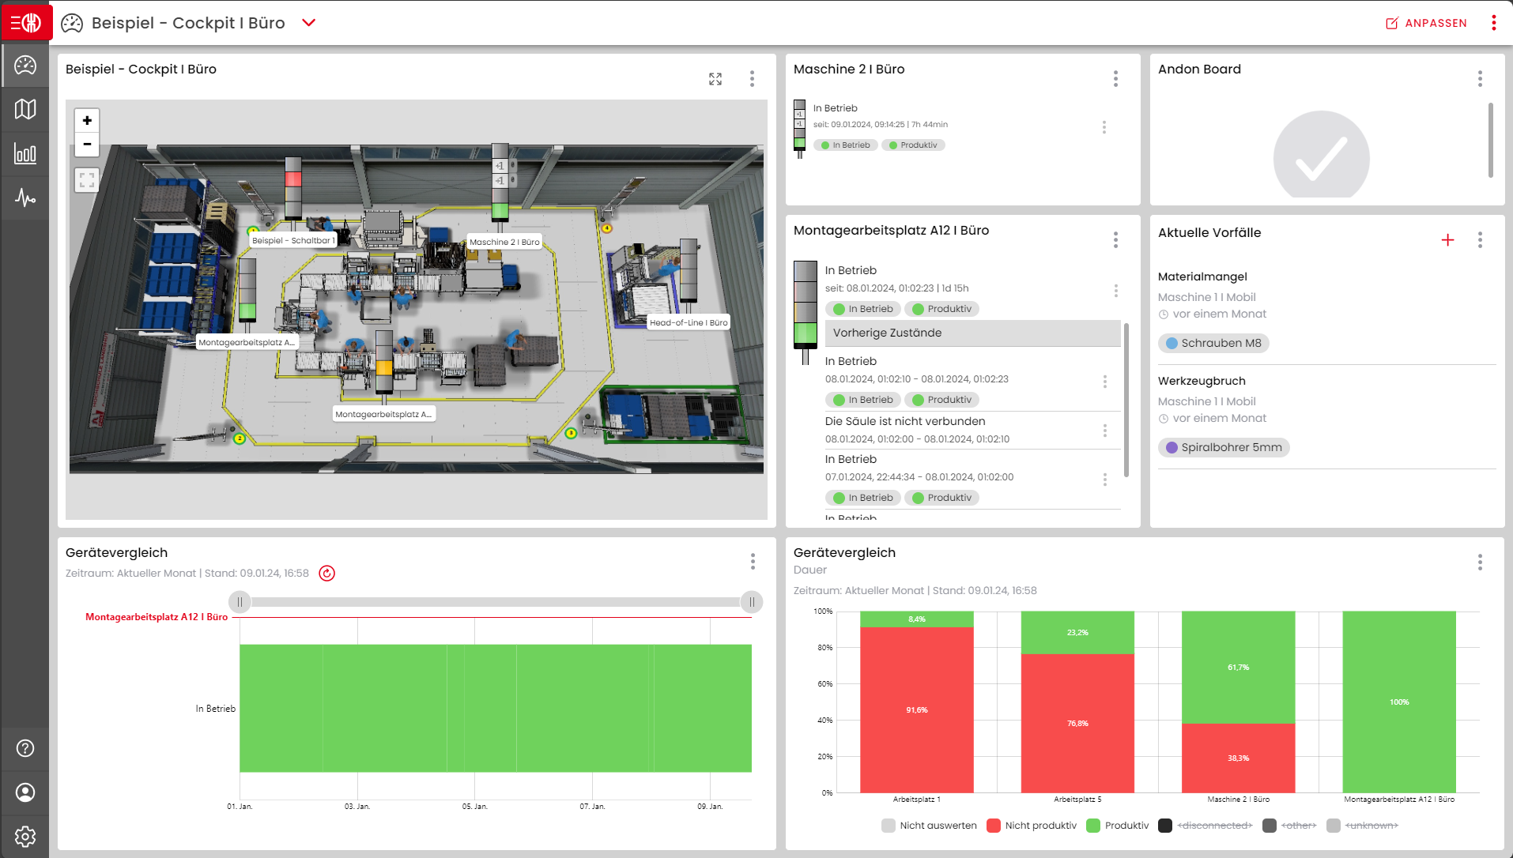

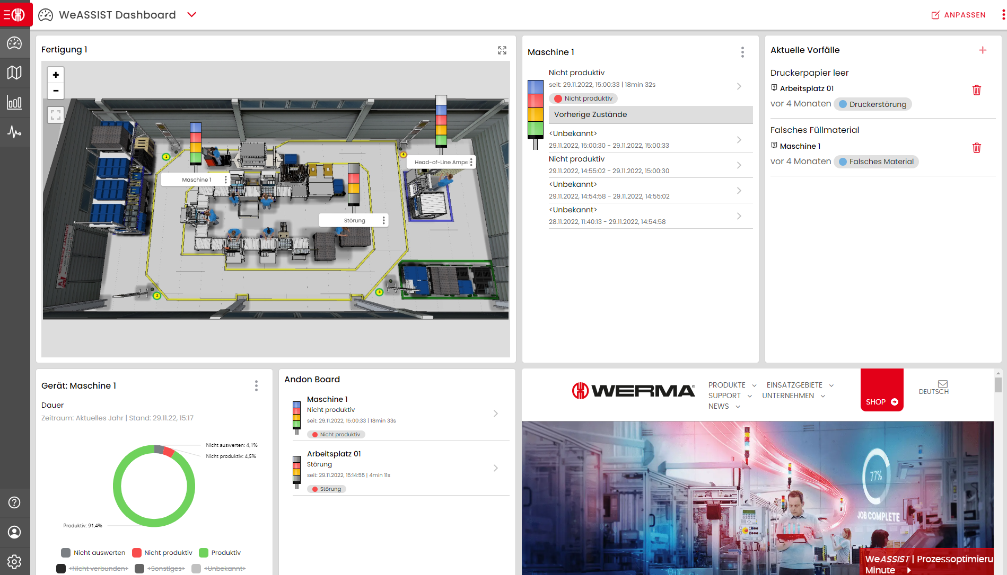
Connection to Azure Cloud
Freely selectable light elements
Data Visualization
Radio network
Transceiver
(Transmitter)
Gateway
(Receiver)
Software
Internet via Ethernet 🡪
Notes:
System architecture:
First, a signal tower with any number of light elements is selected
Transceiver is added as an additional component which records the status of the signal tower and sends it to the gateway via radio network (1st click)
Gateway is the second hardware component, which is connected to the Internet via Ethernet 🡪 This enables data to be stored in the Microsoft Azure Cloud (2nd + 3rd click)
Data from the cloud is then visualized in the software (4th click)

Slide 27
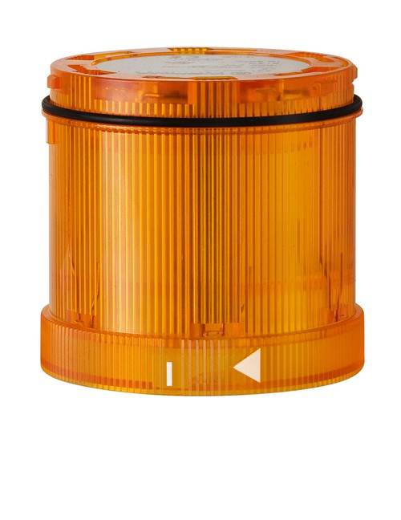
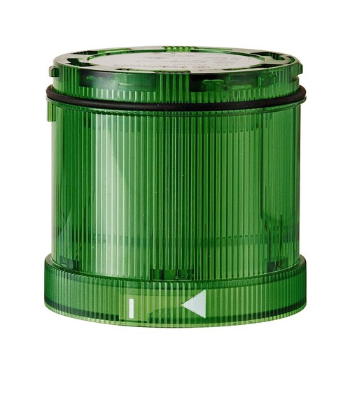
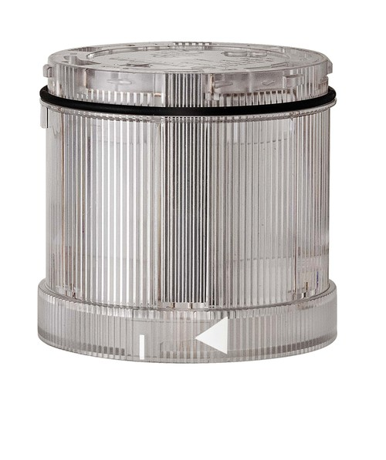
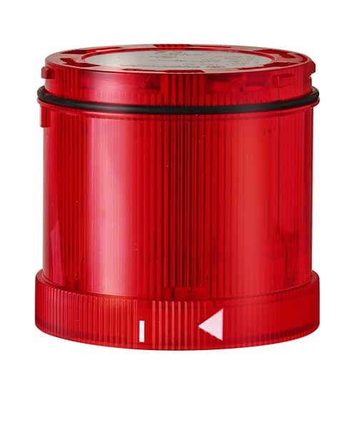
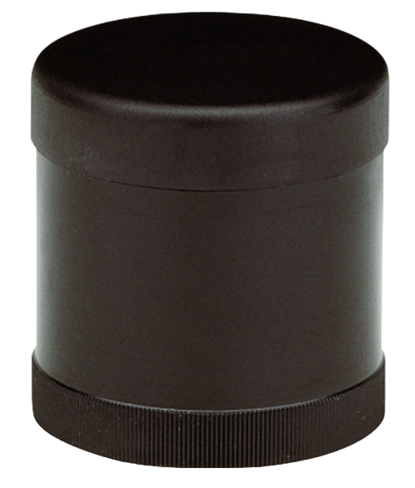
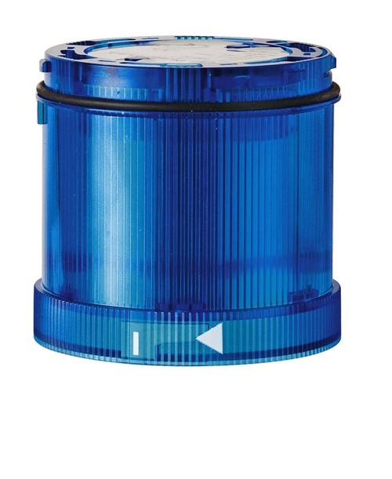
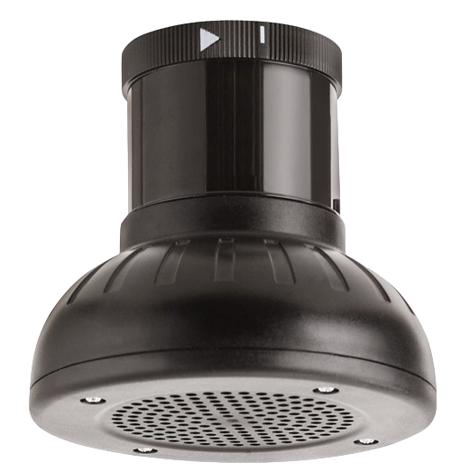

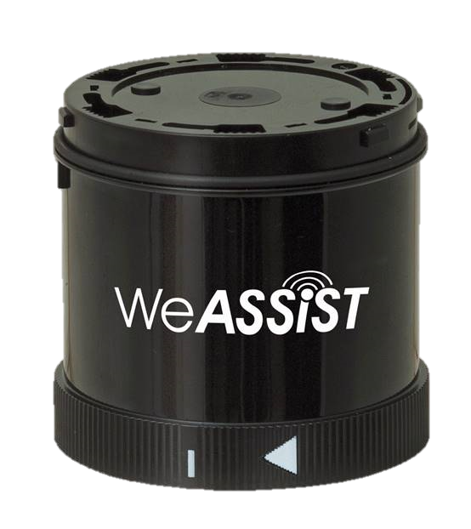


Simple Retrofitting
Simple Interface
Modular design enables easy retrofitting and expansion
Signal tower with Transceiver form the interface to the system
Retrofit
Simple Integration
Simple data transmission
Any machine, workstation or similar can be integrated
Due to radio no need of IT-projects or complex cabling
Notes:
Retrofit:
Possibility to easily retrofit the system to existing machines and workstations
Simple retrofitting thanks to modular design of the signal towers
Simple interface with transceiver grabbing the 24V signals
Easy integration of any type of workstation or machine
Simple data transmission thanks to radio and no cabling required

Slide 28




Infrastructure
Notes:
Infrastructure:
WeASSIST's infrastructure consists of four parts
Hardware, cloud, software and appAll points are explained in more detail below

Slide 29
Hardware
Transceiver
(Transmitter)
Gateway
(Receiver)
24 V Operating voltage
115-230 V power supply
Detects states of the signal tower
Connection to Azure Cloud via Ethernet
Transmitts the states via encrypted radio (921 MHz)
Receives Data from the Transceiver
Range of 984 ft (with Repeater functionality 3,000 ft)
Receives and sends Data
Notes:
Hardware:
Transceiver
24 V
Detects the status of the signal tower and sends it to the gateway via encrypted radio
Range of 984 ft (with Repeater functionality 3.000 ft)
Fully software controlled 5th tier triggerable
50 Transceivers to 1 Gateway
- Gateway
115-230 V with power supply
Establishes a connection to the Azure Cloud via Ethernet
Receives data from all transceivers and can also send data to transceivers

Slide 30

Cloud
Microsoft Azure Cloud
  Easy login to Microsoft Account
  High Data Security due to Microsoft servers
Web-based SaaS Solution
  No Installation required
  No Updates have to be installed
  No Maintenance required
  No Software project required
Data Availability
  Anytime and anywhere available
  Only mobile device with internet connection necessary
Notes:
Cloud:
Microsoft Azure Cloud
Enables easy login with Microsoft data
Also a reliable provider and established in many companies
High data security with data storage in Europe
Web-based SaaS solution
No installation required as it is web-based
Updates are installed automatically 🡪 therefore no IT to-do
No maintenance of own servers or databases
No software project that needs to be managed by IT
Data availability
Anytime, anywhere thanks to the cloud
Only a mobile device with an internet connection is required

Slide 31
Software
Web-based Software
  No Installation required
  http://weassist.werma.com
High level of Customizability and User-Friendliness
  Customizable for every application
  Intuitive and user-friendly interface
  No coding knowledge required
Location-independent access to the entire solution
  Access to the entire solution from any location
  Accessible via any mobile device with internet connection
Notes:
Software:
Web-based software
No installation necessary, simply call up via web address
High level of customizability and user-friendliness
Customizable for every application
User-friendly interface that requires no programming knowledge
Location-independent access to the entire solution
Access to the entire solution from any location
Also with mobile devices such as cell phones or tablets 🡪 Transfer to the app

Slide 32

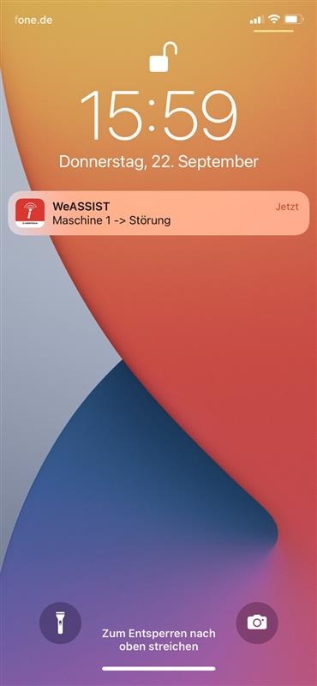
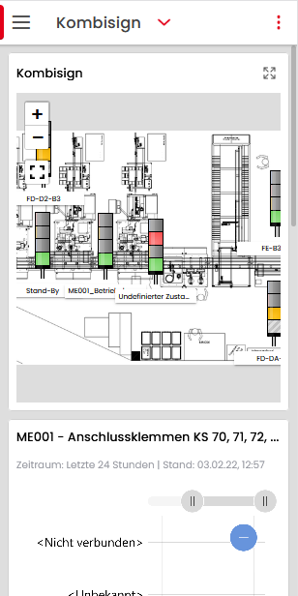


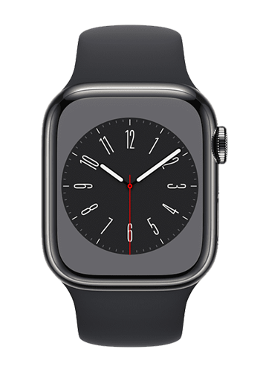
App
Easy to download
  Available for iOS and Android
  Also available for Smartwatches
Push-Notifications
  On your smartphone in case of Incidents etc.
  Notifications visible within a few seconds
  Acknowledge Notifications from your phone
No functional restrictions
  Every functionality available
  Every functionality adjustable
Notes:
App:
Easy to download
Available for IOS and Android
Can also be used on smartwatches
Push notifications
Can be sent directly to cell phone and smartwatch in the event of faults etc.
Acknowledge the Notification and switch a tier on, at the stack light, vocal acknowledgement as well
No functional restrictions
All functions can be displayed and changed

Slide 33


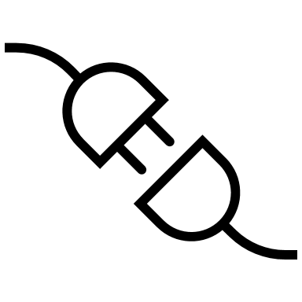




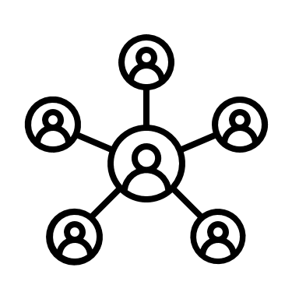

Total Transparency
Continous Process Optimization
Plug & Play retrofit
Customizable
Benefits
Limited need of IT-Department
Data available anytime, anywhere
Over 5.000 happy customers
Notes:
Benefits:
Full transparency of all integrated workstations
Continuous process optimization through analyses and taking measures
Easy to retrofit plug & play solution
Software can be individually adapted and customizable
Limited need of IT-Department
Thanks to the cloud, data is available anytime, anywhere
Reliable partner with over 5000 satisfied system customers

Slide 34












Our References
Notes:
Our references:
- Major partners such as SIEMENS, John Deere, Continental and many more.

Slide 35



Thank you!
We are here for you.
Julian Schmid
Product Manager
julian.schmid@werma.com
Tel: +1 (470) 361-0600
Cell: +1 (678) 301-0154
Notes:
Closing slide:
End of the presentation and opportunity to ask questions
The three buttons can be used to call up the WeASSIST landing page, the WeASSIST blog or the software
Blog is a living construction manual that helps you when questions arise
By clicking on the software, you can show a direct transition to the software and demonstrate simplicity

